Slide 1

Chapter 8 More on Strings and Special Methods

Slide 2
Objectives
To learn how to create strings (§8.2.1).
To use the len, min, and max functions to obtain the length of a string or the smallest or largest element in a string (§8.2.2).
To access string elements by using the index operator ([])(§8.2.3).
To get a substring from a larger string by using the slicing str[start:end] operator (§8.2.4).
To concatenate strings by using the + operator and to duplicate strings by using the * operator (§8.2.5).
To use the in and not in operators to determine whether a string is contained within another string (§8.2.6).
To compare strings by using comparison operators (==, !=, <, <=, >, and >=) (§8.2.7).
To iterate characters in a string by using a foreach loop (§8.2.8).
To test strings by using the methods isalnum, isalpha, isdigit, isidentifier, islower, isupper, and isspace (§8.2.9).
To search for substrings by using the methods endswith, startswith, find, rfind, and count (§8.2.10).
To convert strings by using the methods capitalize, lower, upper, title, swapcase, and replace (§8.2.11).

Slide 3
The str Class
Creating Strings
  s1 = str() # Create an empty string
  s2 = str("Welcome") # Create a string Welcome
Python provides a simple syntax for creating string using a string literal. For example,
  s1 = "" # Same as s1 = str()
  s2 = "Welcome" # Same as s2 = str("Welcome")

Slide 4
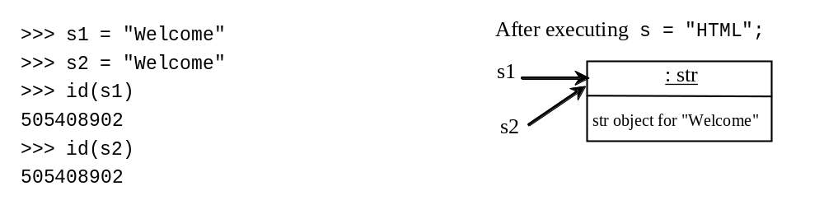
Strings are Immutable
A string object is immutable. Once it is created, its contents cannot be changed. To optimize performance, Python uses one object for strings with the same contents. As shown in Figure 6.8, both s1 and s2 refer to the same string object.

Slide 5
Functions for str
>>> s = "Welcome"
>>> len(s)
7
>>> max(s)
o
>>> min(s)
W

Slide 6
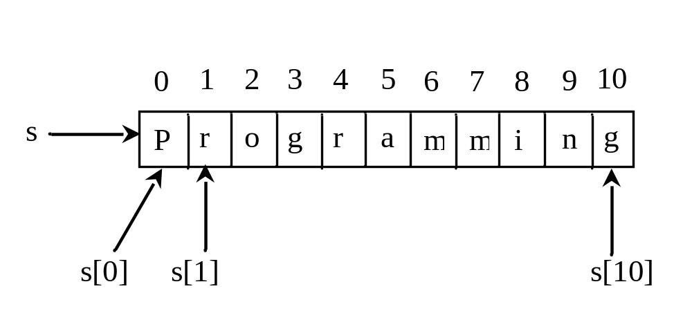
Index Operator []

Slide 7
The +, *, [ : ], and in Operators
>>> s1 = "Welcome"
>>> s2 = "Python"
>>> s3 = s1 + " to " + s2
>>> s3
’Welcome to Python’
>>> s4 = 2 * s1
>>> s4
’WelcomeWelcome’
>>> s1[3 : 6]
’com’
>>> 'W' in s1
True
>>> 'X' in s1
False

Slide 8
Negative Index
>>> s1 = "Welcome"
>>> s1[-1]
‘e’
>>> s1[-3 : -1]
‘me’

Slide 9
The in and not in Operators
>>> s1 = "Welcome"
>>> "come" in s1
True
>>> "come" not in s1
False
>>>

Slide 10
Foreach Loops
for ch in string:
print(ch)
for i in range(0, len(s), 2):
print(s[i])

Slide 11
Comparing Strings
>>> s1 = "green"
>>> s2 = "glow"
>>> s1 == s2
False
>>> s1 != s2
True
>>> s1 > s2
True
>>> s1 >= s2
True
>>> s1 < s2
False
>>> s1 <= s2
False

Slide 12
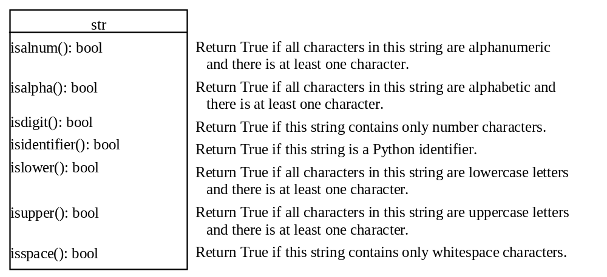
Testing Characters in a String

Slide 13
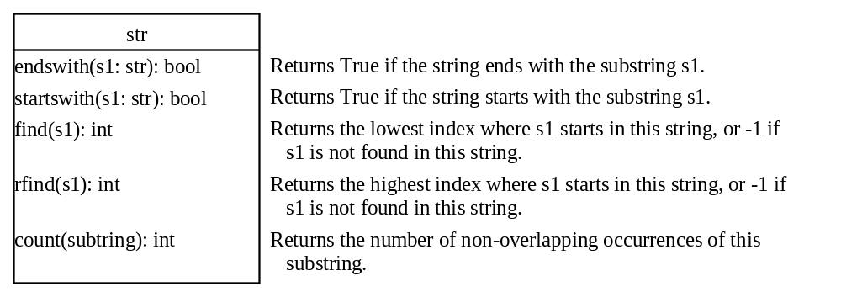
Searching for Substrings

Slide 14
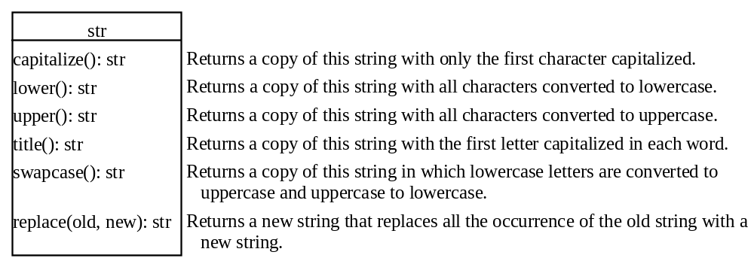
Converting Strings

Slide 15
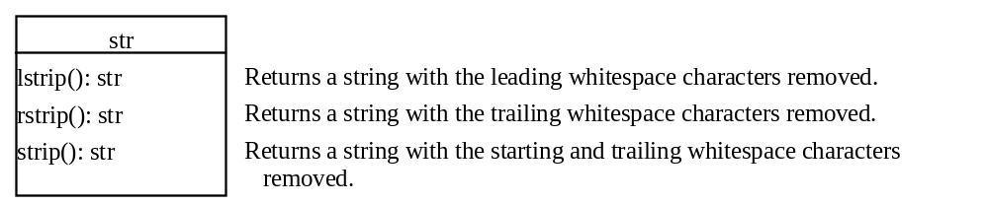
Stripping Whitespace Characters

Slide 16
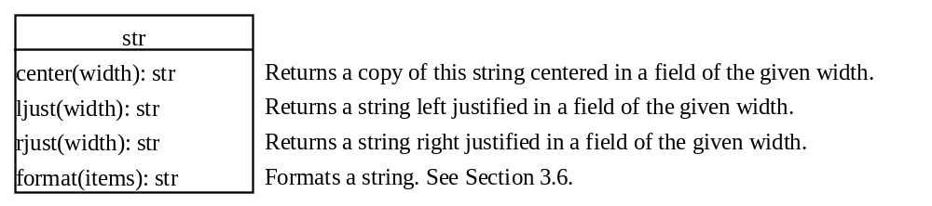
Formatting Strings

Slide 17
Problem: Finding Palindromes
Objective: Checking whether a string is a palindrome: a string that reads the same forward and backward.
CheckPalindrome
Run

Slide 18
Problem: Converting Hex to Decimal
HexToDecimalConversion
Run

Slide 19
Operator Overloading
Defining methods for operators is called operator overloading. Operator overloading allows the programmer to use the built-in operators for user-defined methods. These methods are named in a special way for Python to recognize the association.

Slide 20
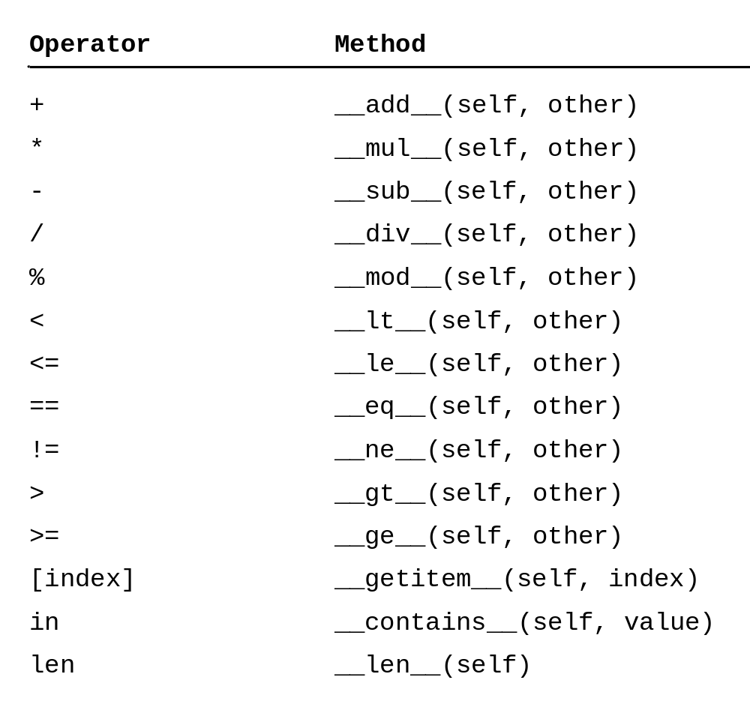
Operators and Methods

Slide 21
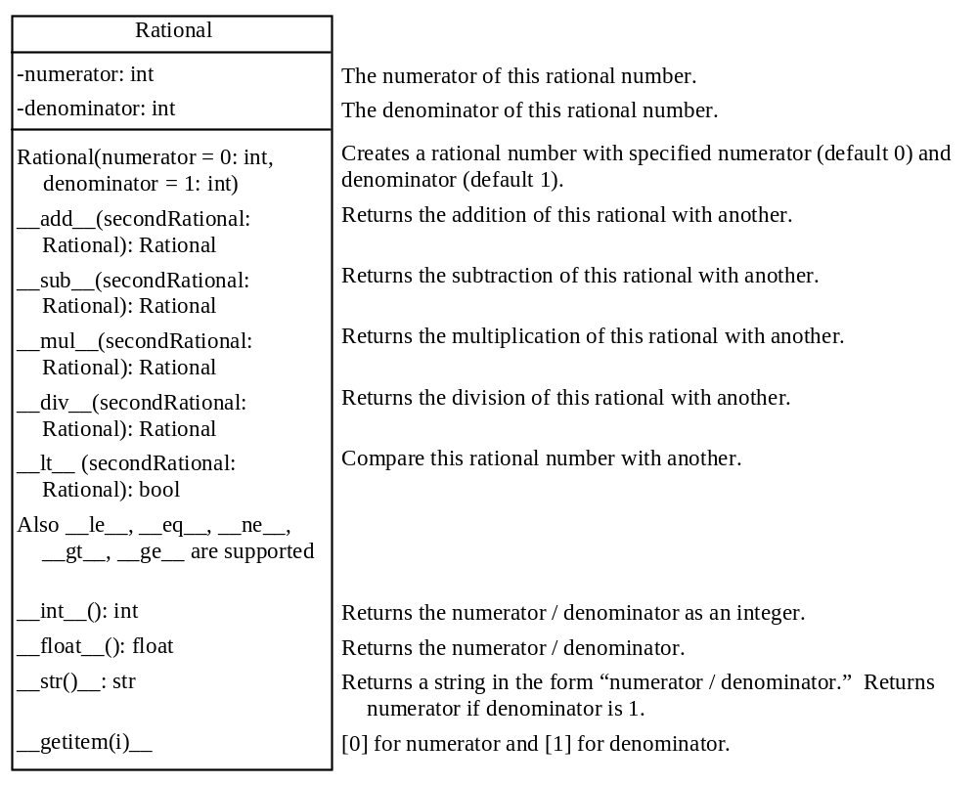
The Rational Class
Rational
TestRationalClass
Run

